Slide 1
A Systematic Review of Predicting Elections Based on Social Media Data
UNDER THE GUIDANCE OF
MR. T. SRINIVASULU
TEAM MEMBERS:
M. CHARAN
M.N.S. GOWTHAM RAJ
B. HARI KETHAN
K. VENKATA SIVA MEGHANA

Slide 2
CONTENTS:
ABSTRACT
INTRODUCTION
EXISTING SYSTEM
DISADVANTAGES
PROPOSED SYSTEM
ADVANTAGES
ARCHITECTURE
SYSTEM REQURIEMENT AND SPECIFICATIONS
ALGORITHM
CONCLUSION

Slide 3
ABSTRACT
Using Natural Language Processing (NLP) and Machine Learning (ML), the system automatically analyzes large-scale social media data to predict election outcomes based on predefined electoral criteria and constraints. It processes bulk data from platforms such as Twitter and Facebook in real time and evaluates them against historical election results and traditional polling data. Additionally, the system examines multiple factors including sentiment, user behavior, and network characteristics to obtain more reliable and comprehensive predictive insights, improving the accuracy and robustness of election forecasting.

Slide 4
INTRODUCTION
Automation: Uses Artificial Intelligence techniques such as Natural Language Processing (NLP) and Machine Learning (ML) to automate the analysis of social media data for predicting election outcomes.
Data Extraction: Extracts election-related opinions, sentiments, and trends from social media.
Electoral Context Analysis: Identifies key election factors such as country, year, and type of election.
Predictive Modeling: Applies machine learning and regression models to relate social media indicators with historical election results.
Scalable System: Processes large volumes of social media data efficiently.
Bias Reduction: Reduces the effect of spam, bias, and misleading information to improve prediction accuracy.

Slide 5
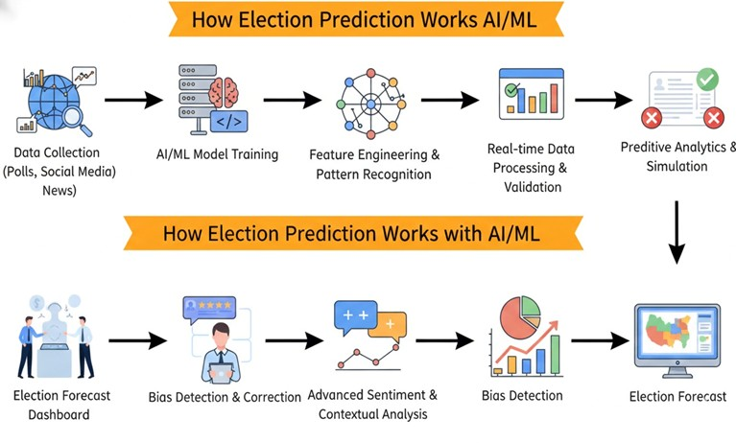

EXSISTING SYSTEM:
Prediction of elections based on manual analysis of polls and traditional survey methods.
Limitations:
Time-consuming
Prone to bias
May produce inaccurate
results due to noise, spam,
and lack of advanced
modeling techniques.

Slide 6
Disadvantages of Existing System:
Parsing Errors: May misinterpret informal or sarcastic political language.
Bias in Training Data: Biased social media samples can lead to inaccurate predictions.
Limited Context Understanding: Fails to capture full political meaning and nuances.
Less Accuracy: Produces unreliable prediction results.
Low Efficiency: Slow and not suitable for large-scale data.

Slide 7
PROPOSED SYSTEM
An AI-based automatic election prediction and analysis system:
Uses Natural Language Processing (NLP) to understand social media content.
Matches public opinions and trends with electoral criteria.
Scores and predicts candidates’ performance.
Features:
Automated social media data collection and preprocessing.
Sentiment and trend analysis.
Machine learning–based prediction and ranking.
Context-aware and bias-reduction filters.

Slide 8
Advantages of proposed system:
High Accuracy: Produces reliable election predictions.
Automated Analysis: Processes social media data automatically.
Opinion Extraction: Identifies public sentiment and trends.
Smart Prediction: Ranks candidates using prediction scores.
Time Efficiency: Reduces time and manual effort.
Improved Insights: Improves forecasting quality.

Slide 9
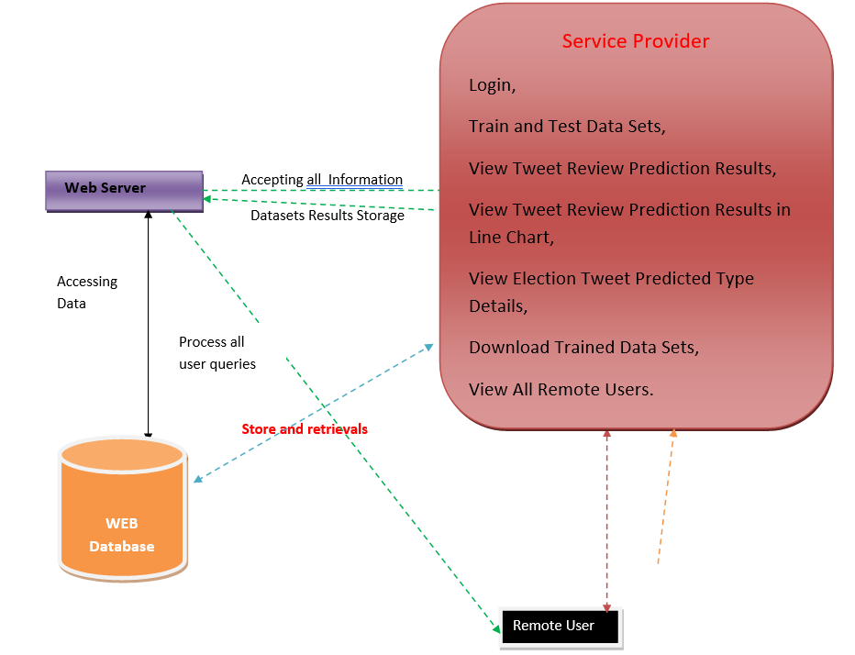
ARCHITECTURE :

Slide 10
Hardware requirements:
Processor : Pentium-IV
RAM : 4 GB (min)
Hard Disk : 20 GB
Keyboard : Standard Windows Keyboard
Mouse : Two or Three Button Mouse
Monitor : SVGA
Software requirements:
Operating system : Windows 7 Ultimate.
Coding Language : Python.
Front-End : Python.
Back-End : Django-ORM
Designing : Html, css, javascript.
Data Base : MySQL (WAMP Server).

Slide 11
Literature Survey
Author & Year of Publication | Applied Technique | Used Algorithms for Performance Analysis | Major Contribution
[1]. Kalampokis et al (2013) | Machine Learning & Statistics | Linear regression, correlation analysis | Analyzed predictive power of social media data for elections.
[2]. Gayo-Avello (2013) | Sentiment & Volume Analysis | Lexicon-based sentiment, regression | Identified limitations of Twitter-based election.
[3]. Prada (2015) | Twitter Analytics | Classification, frequency analysis | Reviewed Twitter-based prediction methods across domains.
[4]. O’Leary (2015) | Predictive Analytics | Regression, trend modeling | Studied social media trends for political forecasting.
[5]. Kwak & Cho (2018) | Survey & Statistical Analysis | Statistical evaluation methods | Showed social media is better for agenda analysis than prediction.
[6]. Koli et al. (2019) | Sentiment Analysis | Naïve Bayes, SVM | Compared prediction performance in developed vs developing countries.
[7]. Bilal et al. (2020) | Multilingual NLP | NLP classifiers, lexicon models | Highlighted challenges in non-English election prediction.
[8]. Ceron et al. (2021) | Machine Learning & Hybrid Models | Regression, ensemble methods | Improved accuracy by combining polls with social media data.

Slide 12
ALGORITHM:
1. Decision Trees : Decision Trees classify data by splitting it into subsets based on feature values and forming a tree structure. In this project, they are used to predict election outcomes from social media features.
2. K-Nearest Neighbours (KNN) : KNN classifies a data point based on the majority class of its nearest neighbors. In this project, it predicts election results by comparing new data with historical data.
3. Logistic Regression : Logistic Regression predicts the probability of a binary outcome using a sigmoid function. In this project, it is used to classify whether a candidate is likely to win or lose.

Slide 13
CONCLUSION:
This paper deals with multiple methods to analyze, identify, and predict election outcomes using social media data through various machine learning and Natural Language Processing models such as Decision Trees, KNN, Logistic Regression, sentiment analysis, and regression techniques.
The accuracy of the models varies based on the quality of social media data, the complexity of the learning methods, and the size and diversity of the dataset, with results ranging from moderate to high accuracy.
We conclude that with a proper dataset, effective preprocessing, and the right algorithm, it is possible to achieve reliable election predictions and meaningful insights for large-scale electoral analysis.

Slide 14
THANK YOU

